Slide 1
All potential options
Choice set
Sampling
Rigorous evaluation
Choice

Slide 2
All options
Choice set
Planning (to compute current value)
Sampling (guided by past value)
= low past value
= medium past value
= high past value

Slide 3
No planning model
Optimal planning model
Sampling (guided by past value)
Planning
(to compute current value)
Choice set model
Extremely cheap
Extremely expensive

Slide 4
Stage 1
Stage 2
BASKET
or
5 points
Decision description, with example and comprehension check
You chose the points.
BASKET = 10 points
You have 30 seconds to enter your word.
Please retype the word and its point value:

Slide 5
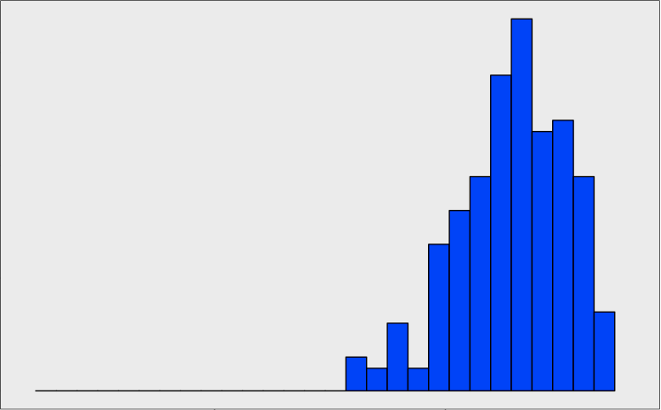
= chance
= mean
Number of
subjects
1
7
11.5
14
Average rank of Stage 2 choices
worst
best
Notes:
- First thing to check: using S2 value

Slide 6
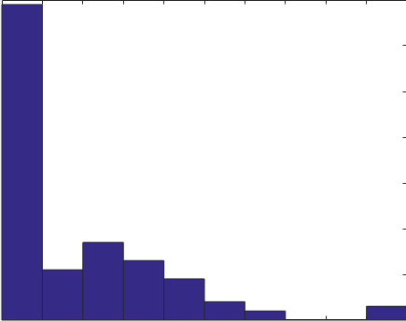
Number of
subjects
0%
50%
100%
Weight on Stage 1 value

Slide 7
All potential options
Choice set
Choice
Cached values
Planning
counting the vertical lines
(i.e. BASKET = 40 points)
the Stage 1 value (i.e. BASKET = 10 points)

Slide 8
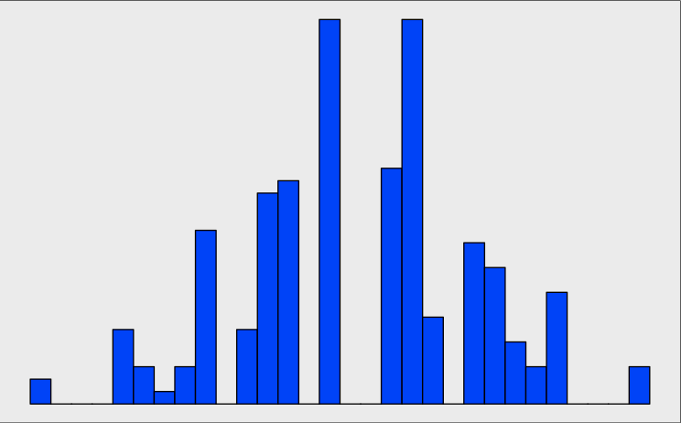
= chance
= mean
Number of
subjects
0%
50%
100%
Percent of Stage 2 choices w/ high Stage 1 values
Notes:
- Then: whether more likely to choose S1 words
Indeed…
So using both. But doesn’t mean CS; could be combining them in some other way.

Slide 9
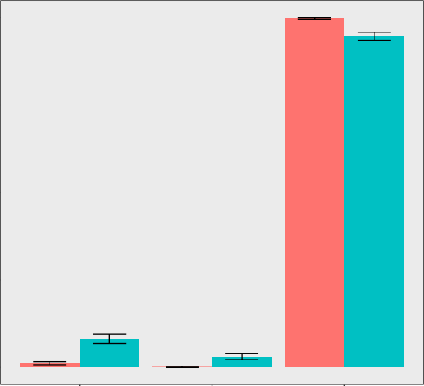

Time delay
Time pressure
% judged impossible
to choose
low Stage 1
value
high Stage 1
value
absent from
Stage 1
Word type

